Slide 1
MATLAB Basics (I)
施心慧
中国海洋大学数学学院

Slide 2
Contents
Brief introduction
The Basic Use of MATLAB
Vector(向量), Matrix（矩阵）, Array（数组）
Variable（变量） and Function（函数）
Plotting（作图）
Program designing

Slide 3

Brief Introduction
MATLAB (Matrix (矩阵) Laboratory) is a special-purpose computer program optimized to perform engineering and scientific calculations.
In the beginning, it was designed to perform matrix mathematics.
Cleve Moler

Slide 4
Brief Introduction
But now it has grown into a flexible computing system capable of solving essentially any technical problem.
It has many powerful toolboxes in many fields, such as Linear Algebra, Numerical Analysis, Optimization, Automatic Control, Signal Processing, Image Processing etc.

Slide 5
Brief Introduction
Its first version was released in 1984 by MathWorks Cooperation.
website: www.mathworks.cn
www.mathworks .com

Slide 6
Brief Introduction
The advantages of MATLAB
Ease of Use
MATLAB can be used as a scratch pad（草稿纸） to evaluate（计算） expressions typed at the command line
It also can be used to execute large prewritten programs.

Slide 7
Brief Introduction
The advantages of MATLAB
Platform Independence
Predefined Functions
Notes:
MATLAB is supported on many different computer systems
MATLAB has an extensive library of predefined functions that provide tested and prepackaged solutions to many basics technical tasks.
Many powerful toolboxes, such as Optimization, Signal Processing, Image Processing, Wavelet, etc

Slide 8
Brief Introduction
Disadvantages of MATLAB
It can be executed more slowly than complied language.

Slide 9
The Basic Use of MATLAB
Vector（向量）, Matrix, Array（数组）
Variable（变量） and Function（函数）
Plotting（绘图）
Program designing

Slide 10
How to define a matrix
Input entries （元素）one by one
Use some built-in functions
‘Chopping’（裁取） and ‘Joining’ （拼接）technique

Slide 11

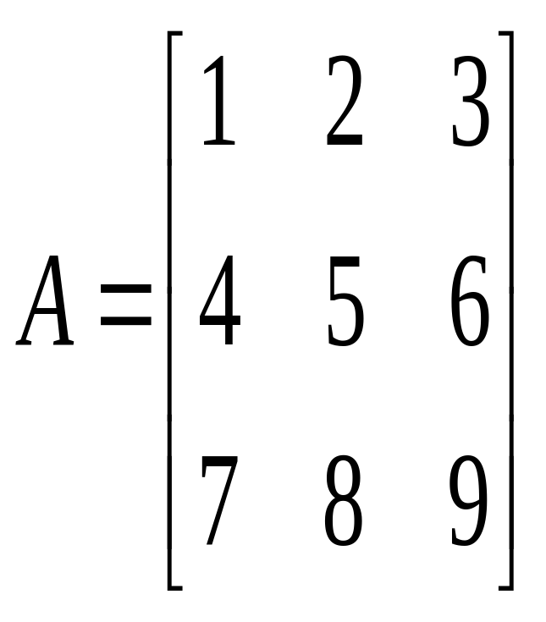
Input the entries one by one
Same result
Example 1
A=[1 2 3;4 5 6;7 8 9]
A=[1,2,3;4,5,6;7,8,9]
A=[1 2 3
4 5 6
7 8 9]

Slide 12
Input the entries one by one
Note
semicolon (分号) ;
enter （回车）
separate two entries of different rows
Coma ,
Space (空格)
separate two entries of same rows

Slide 13
Use some built-in functions
Function | Description
eye(n) | n-by-n identity matrix（单位矩阵）
eye(m,n) | an m-by-n matrix with 1's on the diagonal （对角线）and zeros elsewhere
ones(m,n) ones(n) | an m-by-n matrix with ones elsewhere
zeros(m,n) zeros(n) | an m-by-n matrix with zeros elsewhere

Slide 14
Use some built-in functions
Function | Description
rand(m,n) rand(n) | an m-by-n matrix with random numbers from a uniform distribution （均匀分布）
randn(m,n) randn(n) | an m-by-n matrix with random numbers from a standard normal distribution （标准正态分布）
magic(n) | An n-by-n matrix constructed from the integers （整数）1 through n^2 with equal row, column, and diagonal sums. Produces valid magic squares for all n > 0 except n= 2.

Slide 15
The “chopping”(剪取) and “joining” (拼接) technique
子矩阵
Chopping a matrix
Joining two or several matrices
块矩阵

Slide 16
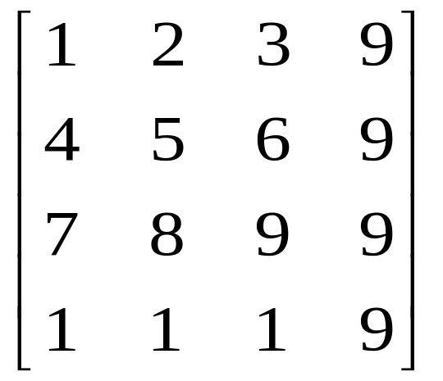
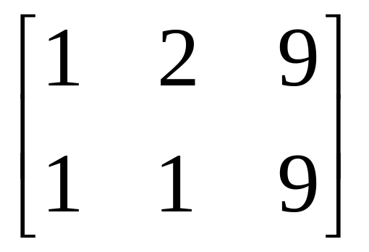
The “chopping” technique
the use of colon(:) and end
Chopping:
rows : 1,4(end)
Columns: 1,2,4(end)

Slide 17
The “chopping” technique
colon(:) 和 end的含义
  colon(:)------所有的
  end------最后的

Slide 18
The “joining” technique
joining: The sizes of the matrices should be appropriate.
Horizontal（横向）: the number of lines should be same
Vertical（纵向）: the number of columns should be same

Slide 19
Matrices Operations
+ Matrix Addition
- Matrix Subtraction
* Matrix Multiplication
\ Matrix Left Division
/ Matrix Right Division

Slide 20
Array Operations
The unique operations:
dot operations
. * ./ .^ .\
element-by-element

Slide 21
Variables and Functions
Variables
The rule of naming a variable or an m-file
Constant（常数）: pi, i, Inf, NaN, eps
String
Built-in Functions
Not a number

Slide 22
The rule of naming a variable or an m-file in MATLAB
MATLAB variable or m-file names must begin with a letter, followed by any combination of letters, numbers, and the underscore(_) character.
Note:
The variable or m-file names should not be as the same as the built-in functions.

Slide 23
The rule of naming a variable or an m-file in MATLAB
Which names are illegal?
dist_1 (2)2018x (3)Len
(4)a bc (5)1 (6)1_x
(7)_help (8)What’s_up?

Slide 24
Functions
MATLAB built-in functions
MATLAB user-defined functions

Slide 25
MATLAB built-in functions
Built-in Functions Versus Scalar(数)
Built-in Functions Versus Matrix（矩阵）
Built-in Functions Versus Array（数组）

Slide 26
Get Help in MATLAB
Type the following in MATLAB command window:
>>help Function Name
or
>>doc Function Name

Slide 27
Built-in Functions Versus Scalar (Matrix, Array)
Examples
log, log10
exp
sin cos tan
ceil, floor, round,fix
abs, sqrt,
mod

Slide 28
Built-in Functions Versus Matrix,Array
Examples
max, min, sum, median,
sort, find

Slide 29
Built-in Functions Versus Matrix,Array
Examples
size,
det, rank, inv,
trace, eig, norm , cond,
lu, svd

